Slide 1
Crypto Currencies Historical Prices
Group 9
Khushboo Thanki
Phuong Nguyen
Yashita Sabharwal

Slide 2

Project Overview
Deep dive into the historical prices of various cryptocurrencies.
Understanding patterns and insights to help investors, traders, and policymakers.
Exploring the dynamics behind these volatile digital assets.

Slide 3

Data Source
Using a comprehensive dataset from Kaggle.
Dataset includes historical prices, volumes, and market caps.
Relevant for answering our key research questions.
Notes:
The analysis utilized 23 historical cryptocurrency data, specifically focusing on key metrics such as closing prices, trading volumes, and market capitalization. The data was filtered for specific symbols representing each cryptocurrency.

Slide 4
Research Questions
01
What are the trends for each targeted cryptocurrency?
02
What are the average, median, and volatility of cryptocurrency prices?
03
Is there a correlation between trading volume and price movements?
04
How do external factors affect cryptocurrency prices?

Slide 5
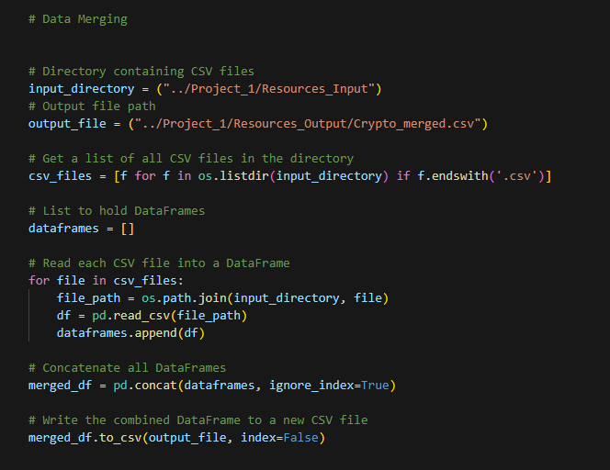
Methodology - Data Cleaning
Combine Data
Analyzed 23 cryptocurrency CSV files, identifying and selecting the top 6 cryptocurrencies based on key performance metrics.

Slide 6
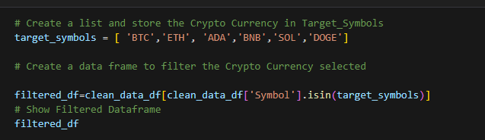
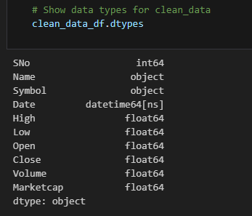
Methodology - Data Cleaning
Data Cleaning
Utilized the Pandas library to efficiently merge the selected CSV files into a unified dataset, facilitating comprehensive analysis.
Convert Datatype
Created a clean_data_df dataframe, standardizing the date format to datetime64[ns] for seamless time-series analysis.

Slide 7
Methodology - Statistical Analysis
01
02
Our aim
The goal
Calculated averages, medians, and volatility for each cryptocurrency.
Provided a quantitative view of cryptocurrency performance.

Slide 8
Statistical Analysis
Currency | Mean Price | Median Price | Volatility
Bitcoin - BTC | 6711.290443071488 | 2286.409912109375 | 0.04263924853868491
Ethereum - ETH | 383.91069131936325 | 198.64369149700002 | 0.06303562022503241
Solana - SOL | 10.471388329287931 | 2.8813885885149997 | 0.09450721975387637
Binance - BNB | 52.250307521403116 | 16.21056933625 | 0.08004986863144231
Dogecoin - DOGE | 0.013762639322080604 | 0.00184435040268945 | 0.11345836448299737
Cardano - ADA | 0.25631264836731377 | 0.08700221665815 | 0.0835979909649701
Notes:
For BTC:
Year (2013-2016) - price below $1000.
Price surge in 2017 reaching $20,000.
Early 2021- Price reach all time high over $60,000
Mean - 6711.29 -Highly skewed
Median 2286.41-middle price
Volatility - 4.26% High Volatility
For BTC Correlation:
Close vs. MarketCap -1- Perfect positive correlation
Close vs. volume-0.81-Strong positive correlation
Volume vs. MarketCap -1- Perfect positive correlation

Slide 9
Key Findings
Bitcoin - BTC
Ethereum - ETH
Solana - SOL
Bitcoin, as expected, has the highest mean price among the listed cryptocurrencies, indicating its dominance in the market.
Ethereum shows a notable difference between its mean and median prices, indicating some level of price skewness or extreme values.
Solana has a low mean price, suggesting it is a more affordable cryptocurrency with potentially high growth prospects.
Binance - BNB
Dogecoin - DOGE
Cardano - ADA
Binance Coin presents a moderate mean price compared to Bitcoin and Ethereum, but like the others, it also shows a significant difference between the mean and median prices, pointing to periods of high price volatility.
Dogecoin stands out for its extremely low mean and median prices, reflecting its origin as a meme coin with low nominal value.
Cardano shows a moderate mean price for a newer cryptocurrency, with a median that is significantly lower, indicating a skewed price distribution.
Notes:
BTC: Bitcoin, as expected, has the highest mean price among the listed cryptocurrencies, indicating its dominance in the market. The large gap between the mean and median price suggests a wide distribution of prices, likely influenced by significant price spikes or drops over time. Despite this, its volatility is relatively low (0.0426), indicating that, while it experiences price fluctuations, it is more stable compared to other cryptocurrencies like Dogecoin or Solana.
ETH: Ethereum shows a notable difference between its mean and median prices, indicating some level of price skewness or extreme values. The volatility of 0.0630 is higher than Bitcoin's, suggesting that Ethereum experiences more frequent or more significant price fluctuations. Ethereum's position as the second-largest cryptocurrency by market capitalization is reflected in its relatively high price and moderate volatility.
SOL: Mean Price: $10.47
Median Price: $2.88
Volatility: 0.0945
Analysis: Solana has a low mean price, suggesting it is a more affordable cryptocurrency with potentially high growth prospects. However, the volatility of 0.0945 indicates that it is one of the more unstable cryptocurrencies, with significant price swings. The disparity between the mean and median price implies that Solana's price is often skewed by outliers or dramatic changes.
Binance Coin (BNB):
Mean Price: $52.25
Median Price: $16.21
Volatility: 0.0800
Analysis: Binance Coin presents a moderate mean price compared to Bitcoin and Ethereum, but like the others, it also shows a significant difference between the mean and median prices, pointing to periods of high price volatility. The volatility of 0.0800 is relatively high, suggesting that while Binance Coin is generally stable, it can experience substantial fluctuations, likely due to its connection to the Binance exchange and broader market conditions.
Dogecoin:
Mean Price: $0.0138
Median Price: $0.0018
Volatility: 0.1135
Analysis: Dogecoin stands out for its extremely low mean and median prices, reflecting its origin as a meme coin with low nominal value. However, its high volatility (0.1135) highlights its speculative nature, where prices can be highly unpredictable, driven by social media trends, celebrity endorsements, or broader market sentiment. This makes Dogecoin a high-risk investment with the potential for both significant gains and losses.
Cardano:
Mean Price: $0.2563
Median Price: $0.0870
Volatility: 0.0836
Analysis: Cardano shows a moderate mean price for a newer cryptocurrency, with a median that is significantly lower, indicating a skewed price distribution. The volatility of 0.0836 suggests that Cardano experiences considerable price fluctuations, though it is slightly more stable compared to Dogecoin. Cardano’s relatively low price and high volatility make it an interesting option for investors looking at emerging technologies in the blockchain space.

Slide 10
Methodology - Visualization
01
02
03
Trend Lines
Correlation Matrix
Box Plot
Trend lines help in understanding the overall movement of a variable, such as the closing price of a cryptocurrency, over a period of time.
The correlation matrix was utilized to analyze the relationships between key variables (Close price, Volume, and Marketcap) for each targeted cryptocurrency.
The box plot was employed to provide a detailed quantitative view of each cryptocurrency's performance, particularly focusing on price distribution.
Notes:
01. Correlation Matrix
Purpose: The correlation matrix was utilized to analyze the relationships between key variables (Close price, Volume, and Marketcap) for each targeted cryptocurrency.
Explanation: By calculating the correlation coefficients, the matrix highlights how closely these variables move together. For example, a strong positive correlation between Close price and Marketcap is expected, as Marketcap is directly influenced by the price. Conversely, the correlation between Volume and Marketcap can provide insights into market activity and its impact on a cryptocurrency’s valuation. This analysis helps to understand the underlying dynamics between different factors that influence the performance of the cryptocurrency.
02. Box Plot
Purpose: The box plot was employed to provide a detailed quantitative view of each cryptocurrency's performance, particularly focusing on price distribution.
Explanation: The box plot displays the spread and skewness of the cryptocurrency prices by showing the median, quartiles, and potential outliers. This visualization helps identify the range of typical prices, the consistency of the cryptocurrency’s performance, and any anomalies (e.g., extreme highs or lows). By visualizing the distribution of prices, stakeholders can gain insights into the stability or volatility of the cryptocurrency, aiding in making informed decisions based on historical performance data.

Slide 11
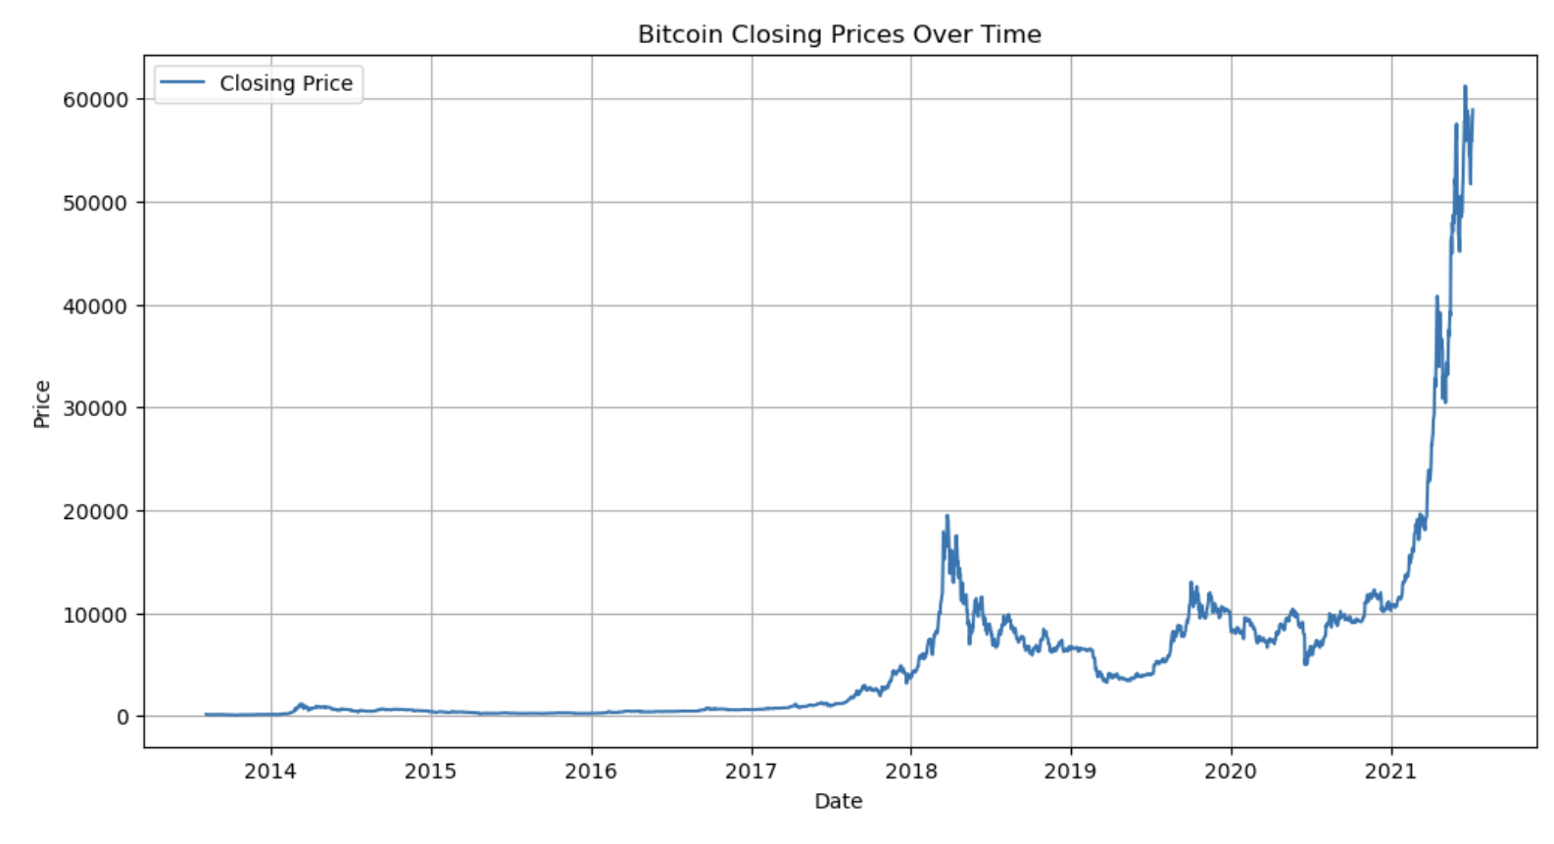
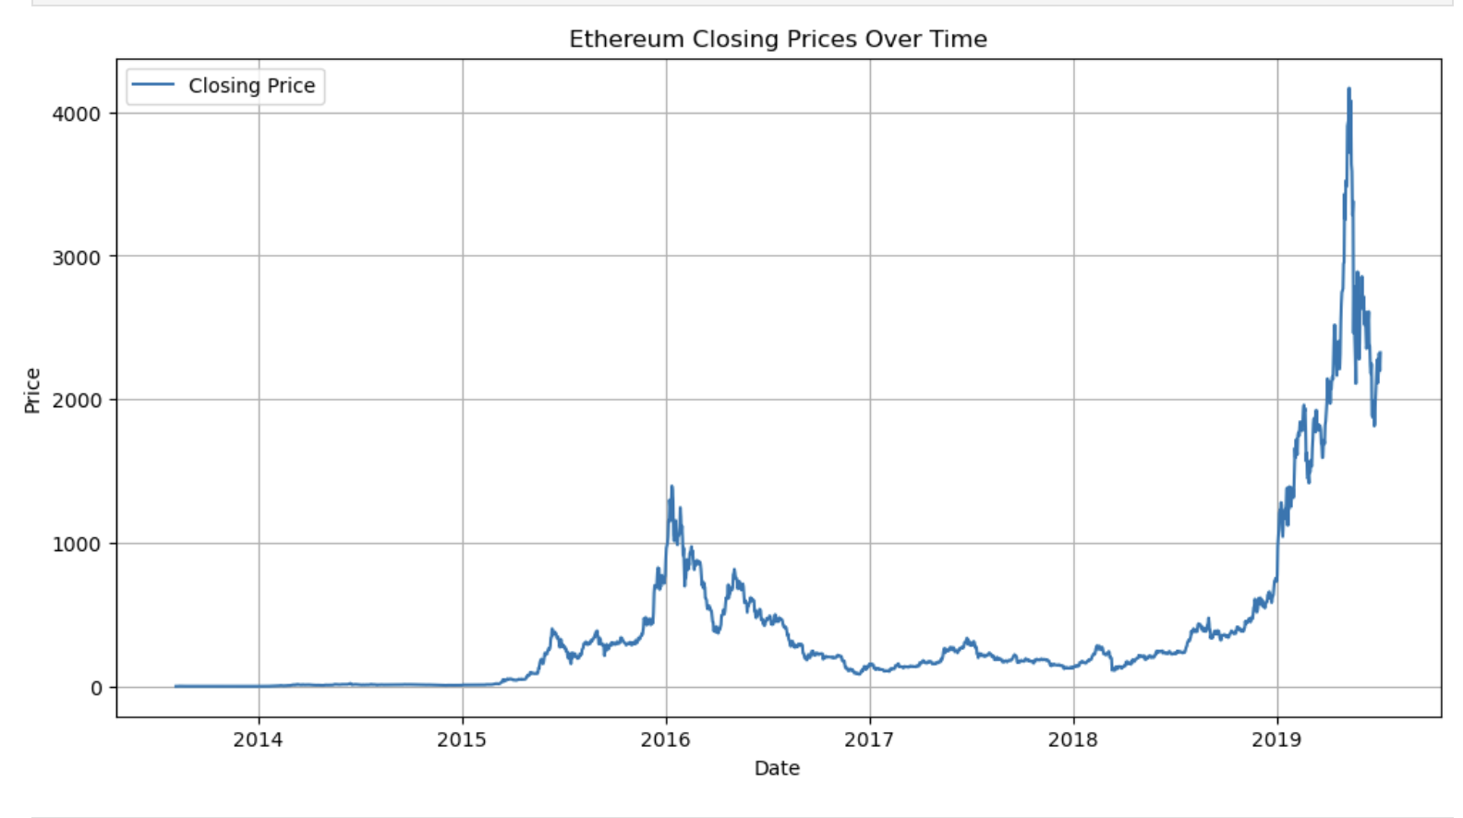
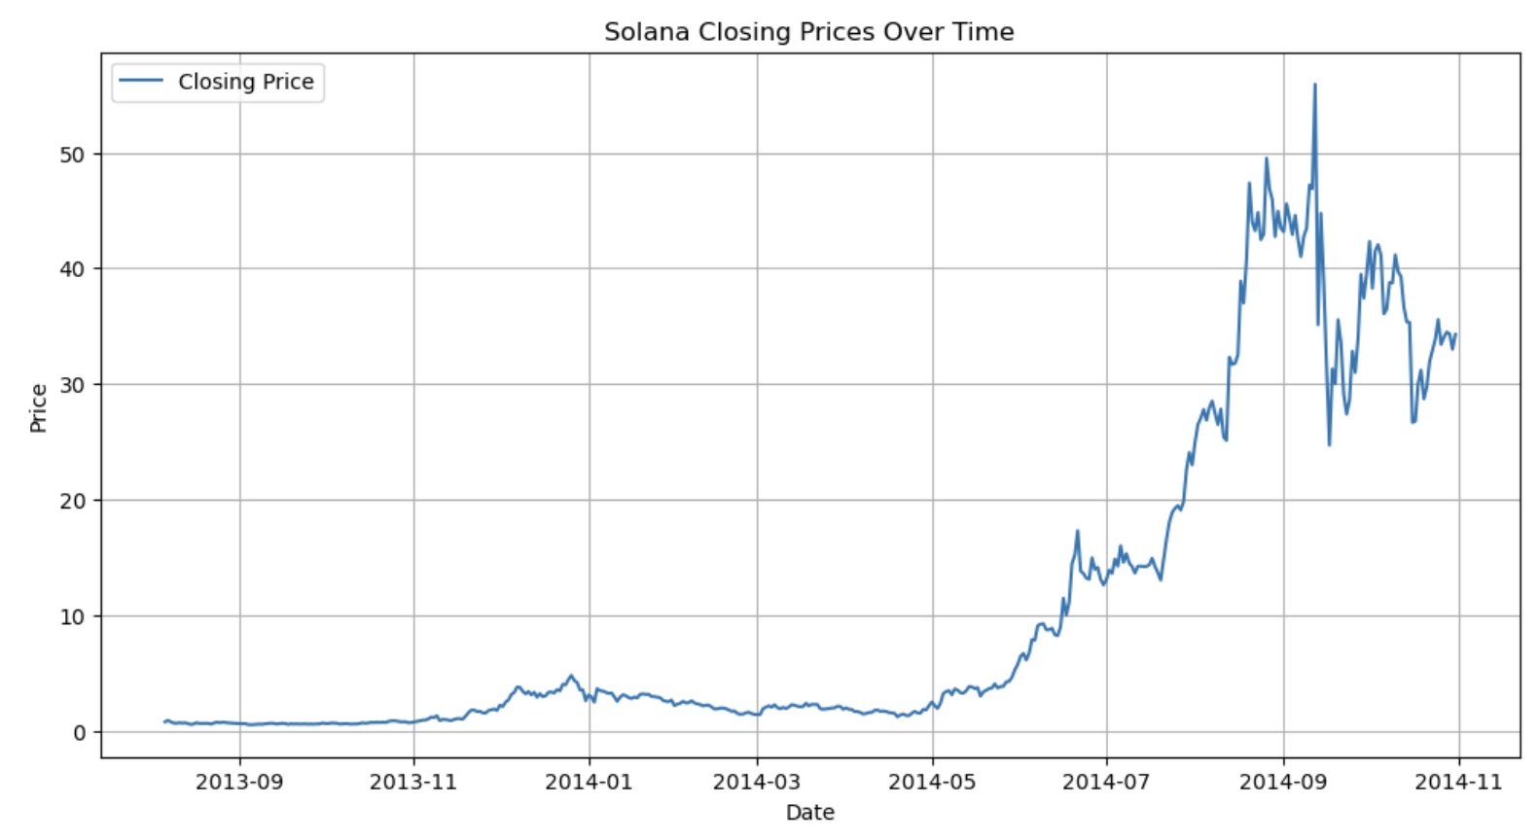
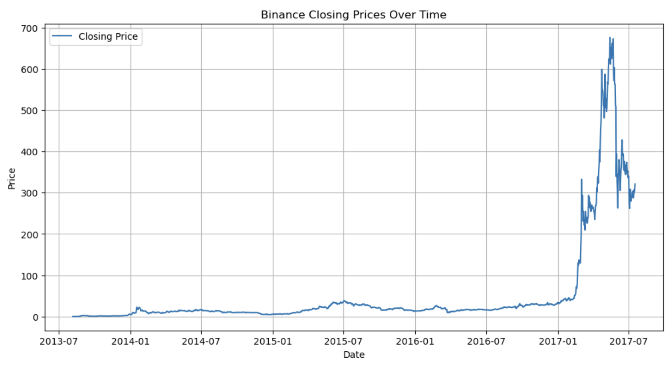
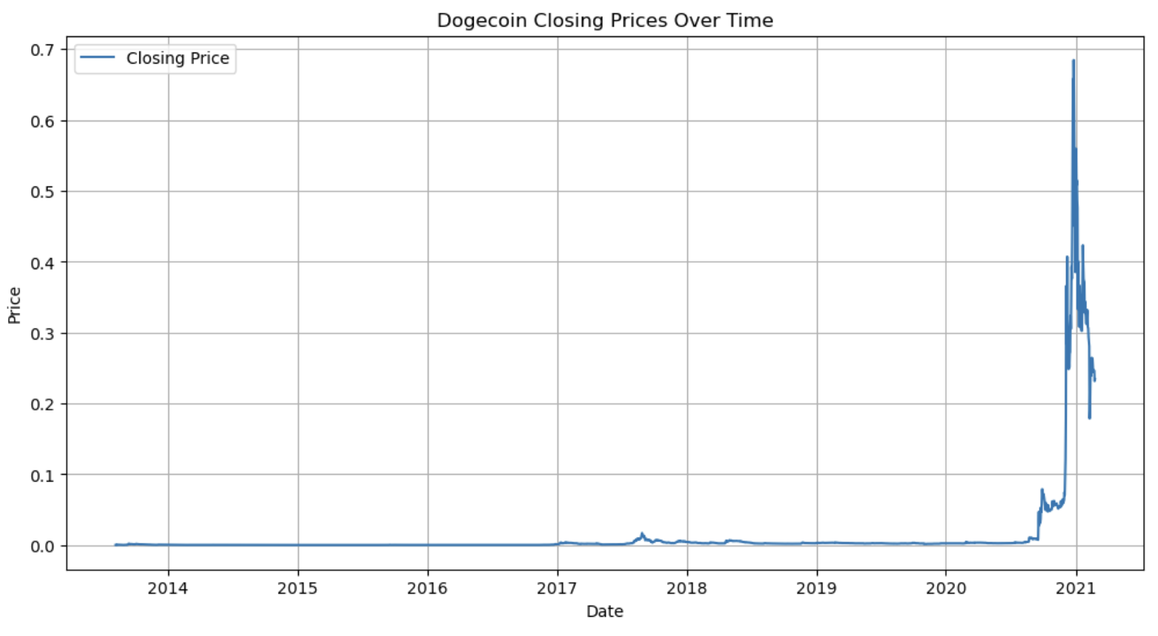
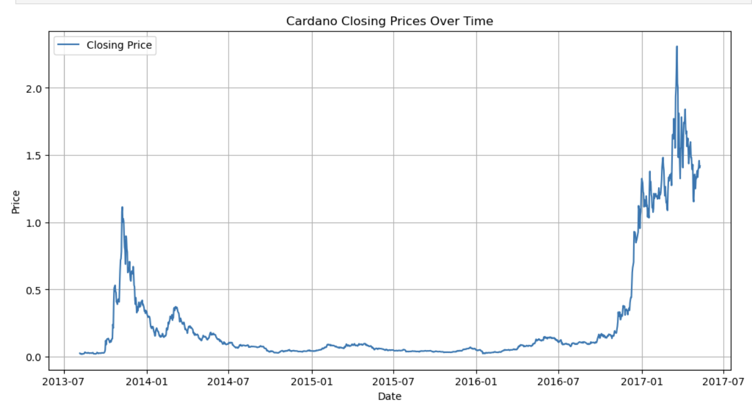
Data Visualization

Slide 12
Data Visualization - BTC and ETH
2013-2016: Bitcoin’s price was relatively low and stable.
2017 Bull Run: A sharp spike to nearly $20,000, followed by a significant correction in 2018.
2020-2021 Rally: Another major surge to around $60,000, driven by institutional adoption and macroeconomic factors.
2015-2016: Low initial prices as Ethereum gained traction.
2017 Bull Run: Price surged to around $1,400, followed by a correction in 2018.
Post-2017: Stabilization and moderate growth.
Notes:
Bitcoin Closing Prices Over Time
Time Span: The graph displays Bitcoin's closing prices from around 2013 to 2021.
Price Trend:
Early Period (2013-2016): Bitcoin’s price remained relatively low, with minor fluctuations, reflecting its nascent stage in the market and lower adoption levels.
2017 Bull Run: A significant upward trend begins in 2017, culminating in a sharp spike in price towards the end of the year. This was the first major bull run for Bitcoin, where it gained mainstream attention and hit nearly $20,000 before experiencing a significant correction in early 2018.
2018-2020: After the 2017 peak, Bitcoin’s price went through a prolonged period of correction, known as the "crypto winter," where prices fell and stabilized at lower levels.
2020-2021 Rally: Starting in late 2020, Bitcoin experienced another sharp rise, reaching new all-time highs in 2021, driven by factors such as institutional adoption, macroeconomic factors like inflation concerns, and increasing interest from retail investors. The price reached around $60,000, showcasing its volatile nature and potential for rapid growth.
Ethereum Closing Prices Over Time
Time Span: The graph illustrates Ethereum's closing prices from its inception in 2015 up to around 2019.
Price Trend:
Early Period (2015-2016): Ethereum’s price was very low during its initial years, as it was still relatively unknown and in the process of establishing its platform and use cases.
2017 Bull Run: Similar to Bitcoin, Ethereum saw a significant price increase in 2017. The price surged dramatically as the platform gained popularity for its smart contract capabilities, driving demand for Ether (ETH) as a utility token. Ethereum reached a peak of around $1,400 in early 2018.
Post-2017 Correction: After the 2017 peak, Ethereum experienced a substantial correction, with prices dropping sharply in 2018, mirroring the broader cryptocurrency market downturn. However, Ethereum’s price began to stabilize and saw moderate growth in subsequent years.
Early 2020s (Not fully shown): While the graph ends around 2019, Ethereum's price would later experience a similar pattern to Bitcoin, with a significant rally in 2020-2021, largely driven by the explosion of decentralized finance (DeFi) and non-fungible tokens (NFTs), both of which heavily utilize the Ethereum network.

Slide 13
Data Visualization - SOL and BNB
Early Growth: Initially low prices with a gradual increase in early 2014.
Mid-2014 Surge: A significant rise in mid-2014, peaking above $50 before experiencing some volatility and a subsequent decline.
Stable Period: BNB prices remained low and stable for several years, reflecting its early-stage development.
Late 2016-2017 Bull Run: A dramatic increase in price starting in late 2016, peaking around $700 in 2017. This surge aligns with the broader cryptocurrency market boom during this period, driven by increased adoption and the growth of the Binance exchange.
Notes:
Solana (SOL) Closing Prices Over Time
- Time Span: Approximately 2013 to 2014.
- Price Trend:
- Early Growth: Initially low prices with a gradual increase in early 2014.
-Mid-2014 Surge: A significant rise in mid-2014, peaking above $50 before experiencing some volatility and a subsequent decline.
- Volatility: The sharp fluctuations suggest early adoption and speculative trading, characteristic of emerging cryptocurrencies.
Binance Coin (BNB) Closing Prices Over Time
- Time Span: 2013 to 2017.
- Price Trend:
- Stable Period: BNB prices remained low and stable for several years, reflecting its early-stage development.
- Late 2016-2017 Bull Run: A dramatic increase in price starting in late 2016, peaking around $700 in 2017. This surge aligns with the broader cryptocurrency market boom during this period, driven by increased adoption and the growth of the Binance exchange.
- Volatility: The price spike and subsequent drop in 2017 highlight BNB's susceptibility to market cycles.
Overall Insights:
- Both Solana and Binance Coin experienced sharp increases in their respective periods, driven by market speculation and growing adoption.
- The volatility in both charts indicates the risks and rewards associated with investing in emerging cryptocurrencies, particularly during periods of rapid market expansion.

Slide 14
Data Visualization - DOGE and ADA
Time Span: 2014 to 2021.
Price Trend: Mostly flat and low until 2020, followed by a dramatic spike in 2021, peaking around $0.70. This surge was driven by social media hype and celebrity endorsements, illustrating Dogecoin’s speculative nature.
Time Span: 2013 to 2017.
Price Trend: Early volatility in 2014 with a peak above $2, followed by a long period of stability. A significant rise occurred in 2017, aligned with the broader market boom, peaking around $2.50.

Slide 15
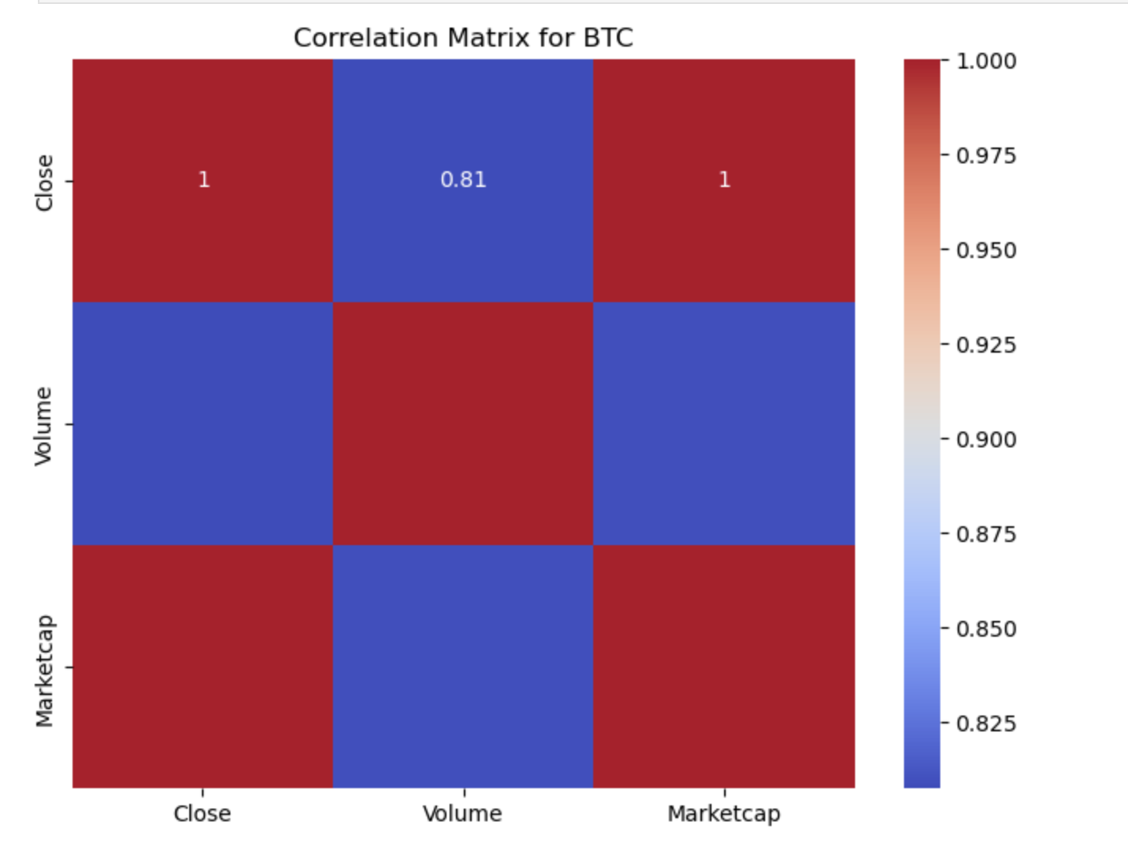
Correlation Matrix - BTC
Correlation Matrix for Bitcoin (BTC)
Close vs. Marketcap: The correlation coefficient is 1, indicating a perfect positive correlation. This is expected since Marketcap is directly calculated by multiplying the Close price by the circulating supply of Bitcoin.
Close vs. Volume: The correlation coefficient is 0.81, showing a strong positive correlation. This suggests that as the closing price of Bitcoin increases, the trading volume tends to rise as well, indicating higher market activity during price surges.
Correlation Matrix for BTC
Notes:
Strong Correlation: Bitcoin’s price is closely tied to its market cap, as expected. The strong correlation with volume also suggests that higher prices attract more trading activity.
Market Dynamics: While volume does impact market cap, it’s the price that predominantly drives changes in Bitcoin’s market valuation.

Slide 16
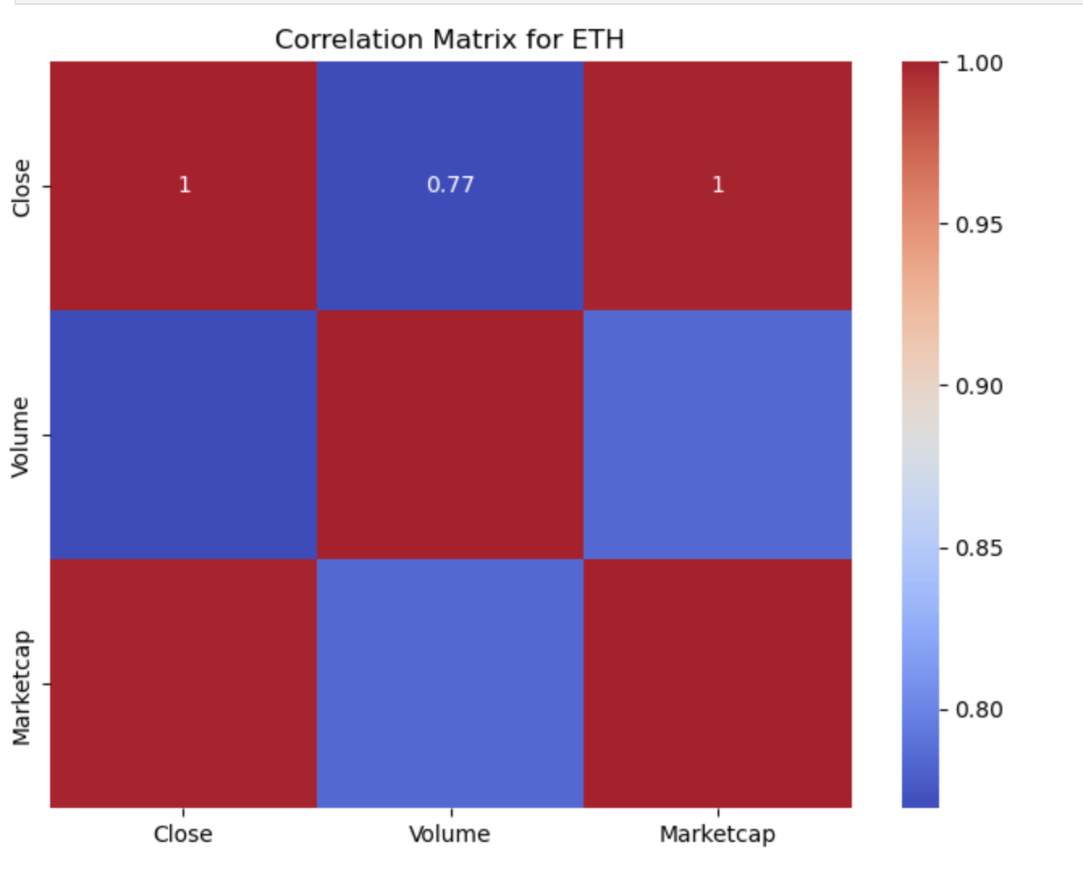
Correlation Matrix - ETH
Correlation Matrix for Ethereum (ETH)
Close vs. Marketcap: The correlation coefficient is 1, indicating a perfect positive correlation. This is expected as Marketcap is directly influenced by the Close price, given that Marketcap is calculated by multiplying the Close price by the circulating supply.
Close vs. Volume: The correlation coefficient is 0.77, showing a strong positive correlation. This suggests that as Ethereum’s closing price increases, trading volume tends to rise, reflecting heightened trading activity during price movements.
Correlation Matrix for ETH
Notes:
Strong Correlation: Ethereum’s price is closely linked to its market cap, reflecting the direct influence of price on the valuation.
Market Activity: The positive correlation with volume indicates that Ethereum sees increased trading activity when prices rise, though volume alone is less influential on the market cap than price.

Slide 17
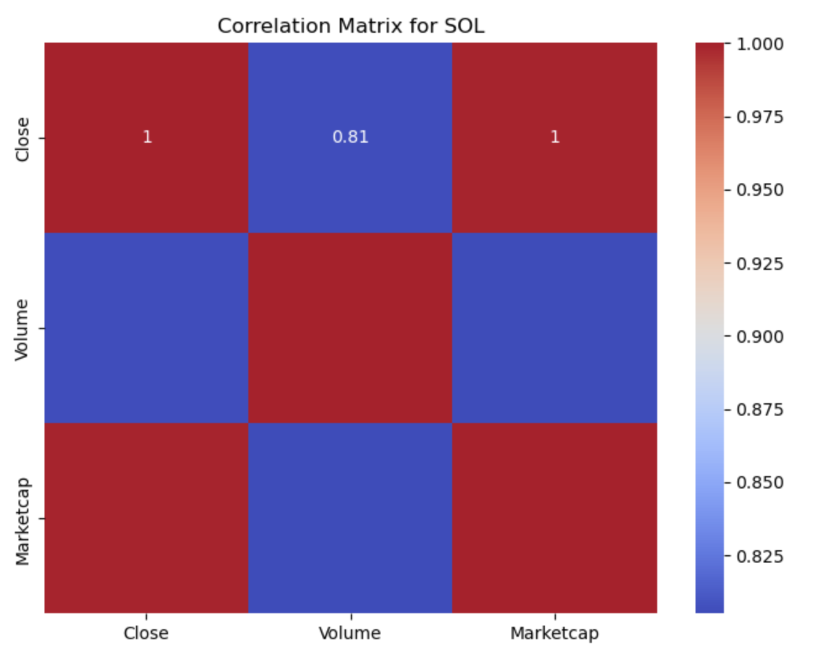
Correlation Matrix - SOL
Correlation Matrix for Solana (SOL)
Close vs. Marketcap: The correlation coefficient is 1, indicating a perfect positive correlation. This is expected because Marketcap is directly determined by the Close price multiplied by the circulating supply of Solana.
Close vs. Volume: The correlation coefficient is 0.81, showing a strong positive correlation. This suggests that as Solana’s closing price increases, the trading volume typically rises, indicating more market activity during price surges.
Correlation Matrix for SOL
Notes:
Strong Price-Driven Marketcap: Solana’s market cap is closely tied to its price movements, as reflected by the perfect correlation between Close and Marketcap.
Volume Correlation: While trading volume does increase with price, it has a less direct impact on market cap compared to price changes, indicating that market cap fluctuations are more price-driven than volume-driven.

Slide 18
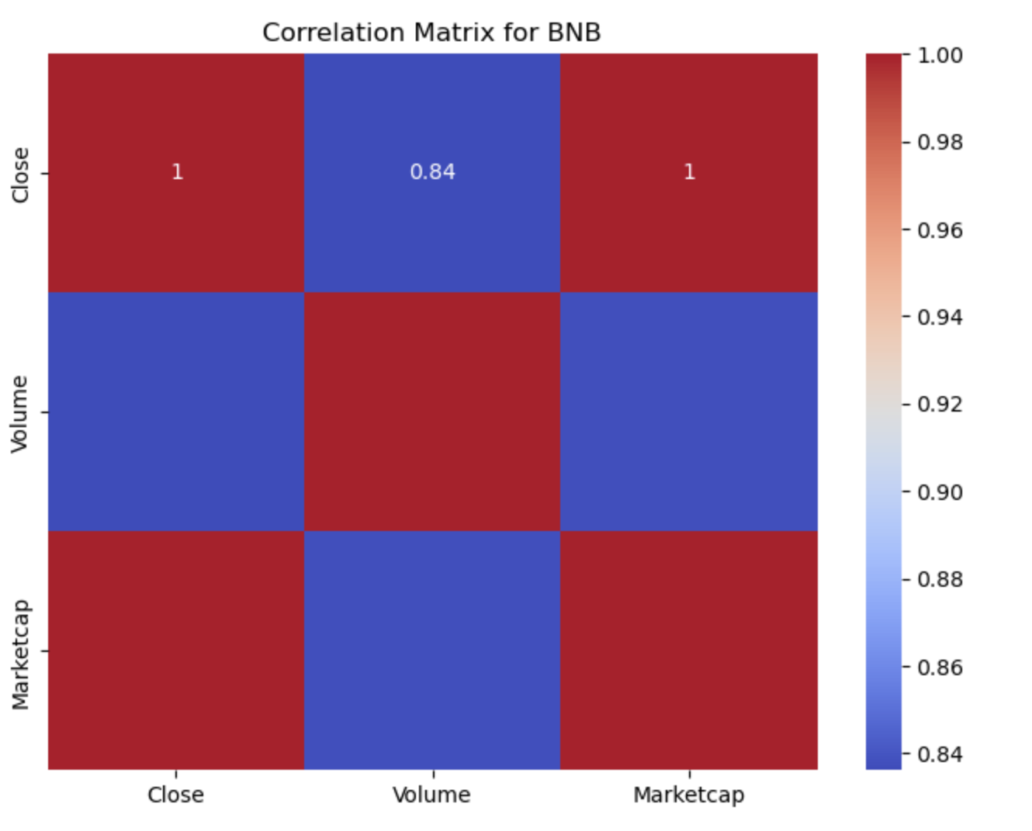
Correlation Matrix - BNB
Correlation Matrix for Binance Coin (BNB)
Close vs. Marketcap: The correlation coefficient is 1, indicating a perfect positive correlation. This is expected, as Marketcap is directly influenced by the Close price, calculated by multiplying the price by the circulating supply.
Close vs. Volume: The correlation coefficient is 0.84, showing a strong positive correlation. This suggests that as BNB’s closing price increases, the trading volume tends to rise as well, reflecting increased market activity during price movements.
Correlation Matrix for BNB
Notes:
Price-Driven Marketcap: BNB’s market cap is closely tied to its price, reflecting the perfect correlation between Close and Marketcap.
Volume Influence: There is a strong correlation between price and volume, indicating that higher prices are often accompanied by higher trading volumes. However, market cap fluctuations are primarily driven by price changes rather than volume alone.

Slide 19
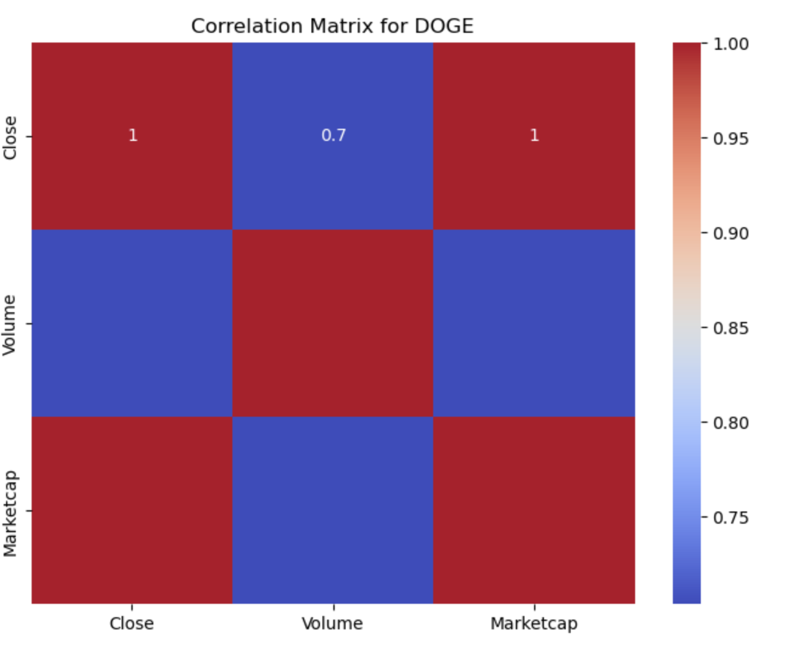
Correlation Matrix - DOGE
Correlation Matrix for Dogecoin (DOGE)
Close vs. Marketcap: The correlation coefficient is 1, indicating a perfect positive correlation. This is expected since Marketcap is directly influenced by the Close price, calculated by multiplying the price by the circulating supply.
Close vs. Volume: The correlation coefficient is 0.7, indicating a moderate positive correlation. This suggests that as Dogecoin’s closing price increases, the trading volume also tends to increase, but the relationship is not as strong as seen in some other cryptocurrencies.
Correlation Matrix for DOGE
Notes:
Market Cap Dependence: Dogecoin’s market cap is highly dependent on its price, as shown by the perfect correlation between Close and Marketcap.
Moderate Volume Influence: The moderate correlation between price and volume reflects that while trading activity increases with price, it is not the dominant factor in market cap fluctuations. Dogecoin’s market cap is primarily driven by price changes rather than trading volume.

Slide 20
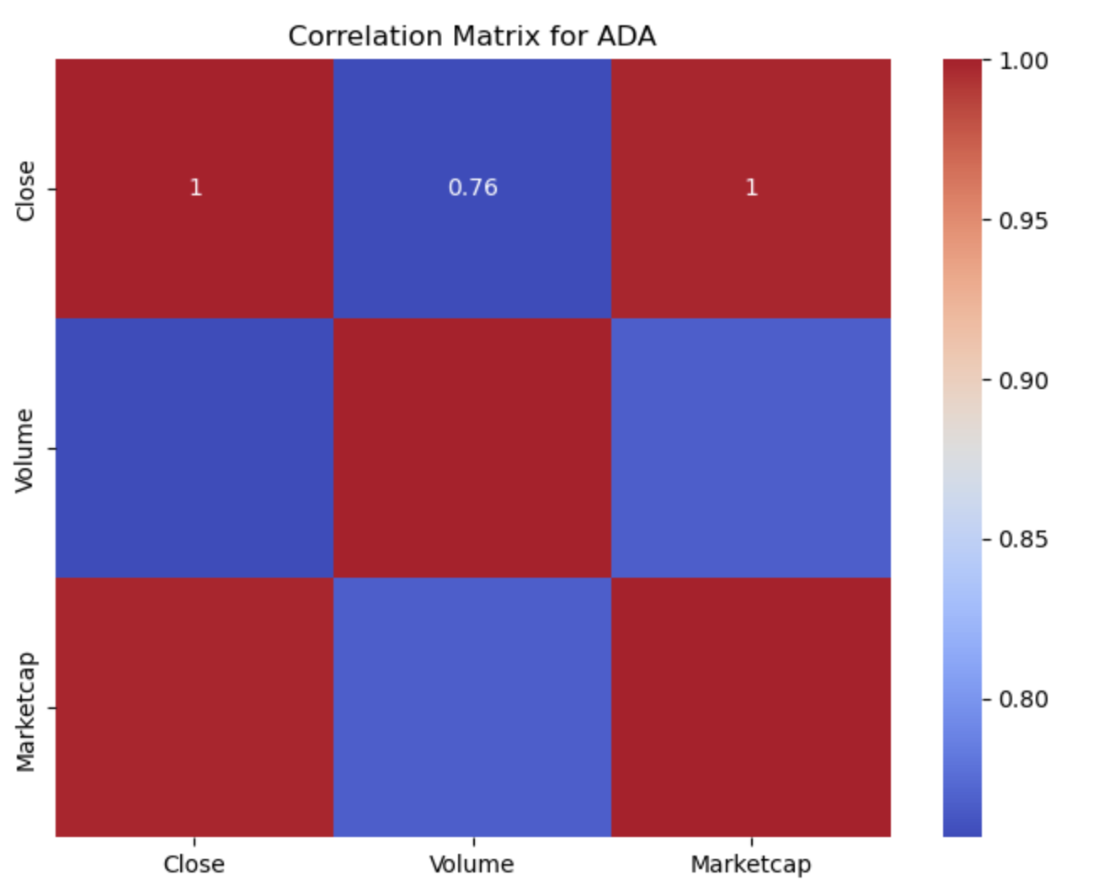
Correlation Matrix - ADA
Correlation Matrix for Cardano (ADA)
Close vs. Marketcap: The correlation coefficient is 1, indicating a perfect positive correlation. This is expected as Marketcap is directly influenced by the Close price, given that Marketcap is calculated by multiplying the price by the circulating supply.
Close vs. Volume: The correlation coefficient is 0.76, indicating a strong positive correlation. This suggests that as Cardano’s closing price increases, the trading volume tends to rise, reflecting increased market activity during price movements.
Correlation Matrix for ADA
Notes:
Price-Driven Marketcap: Cardano’s market cap is highly dependent on its price, as shown by the perfect correlation between Close and Marketcap.
Volume Influence: The strong correlation between price and volume indicates that trading activity increases with price, but market cap changes are primarily driven by price fluctuations rather than trading volume.

Slide 21
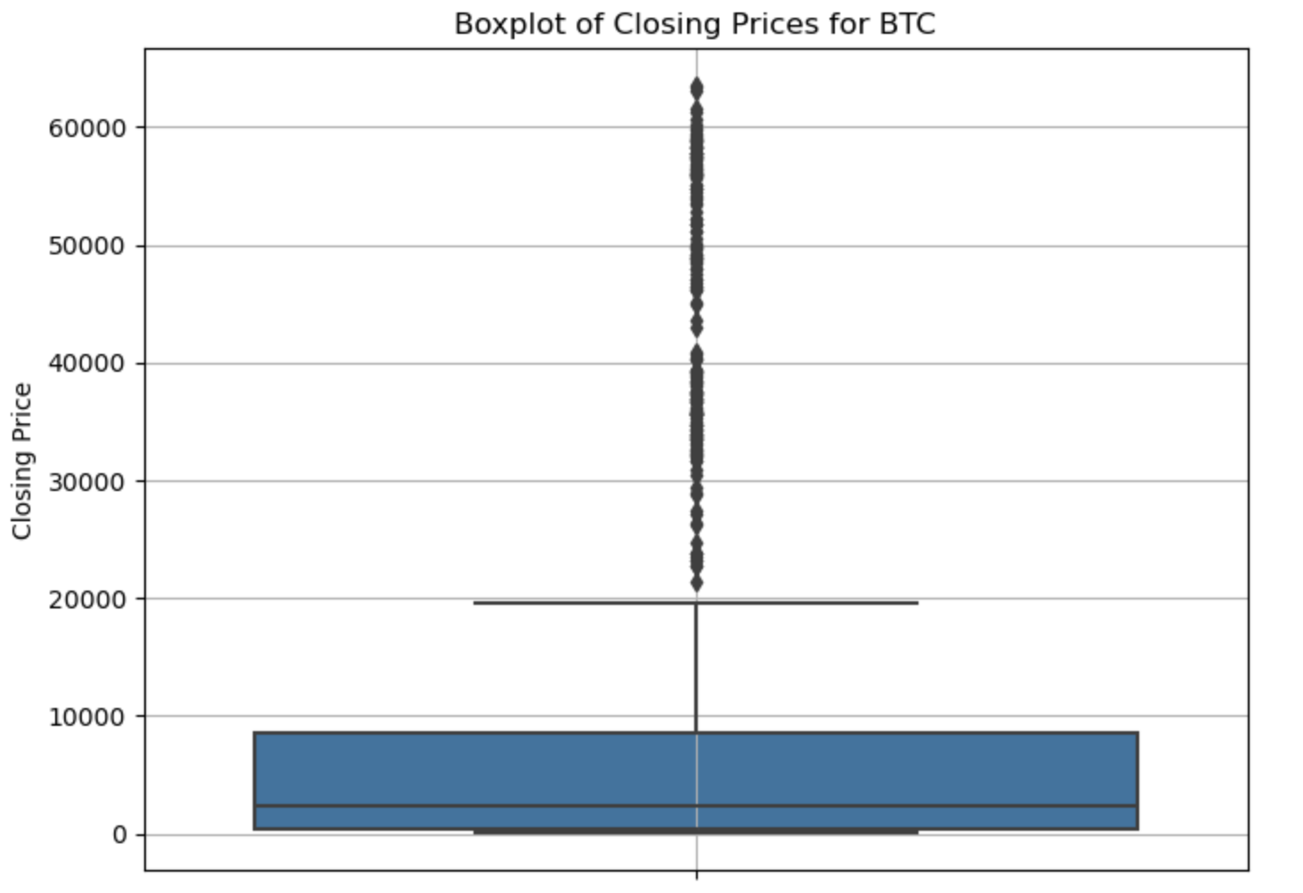
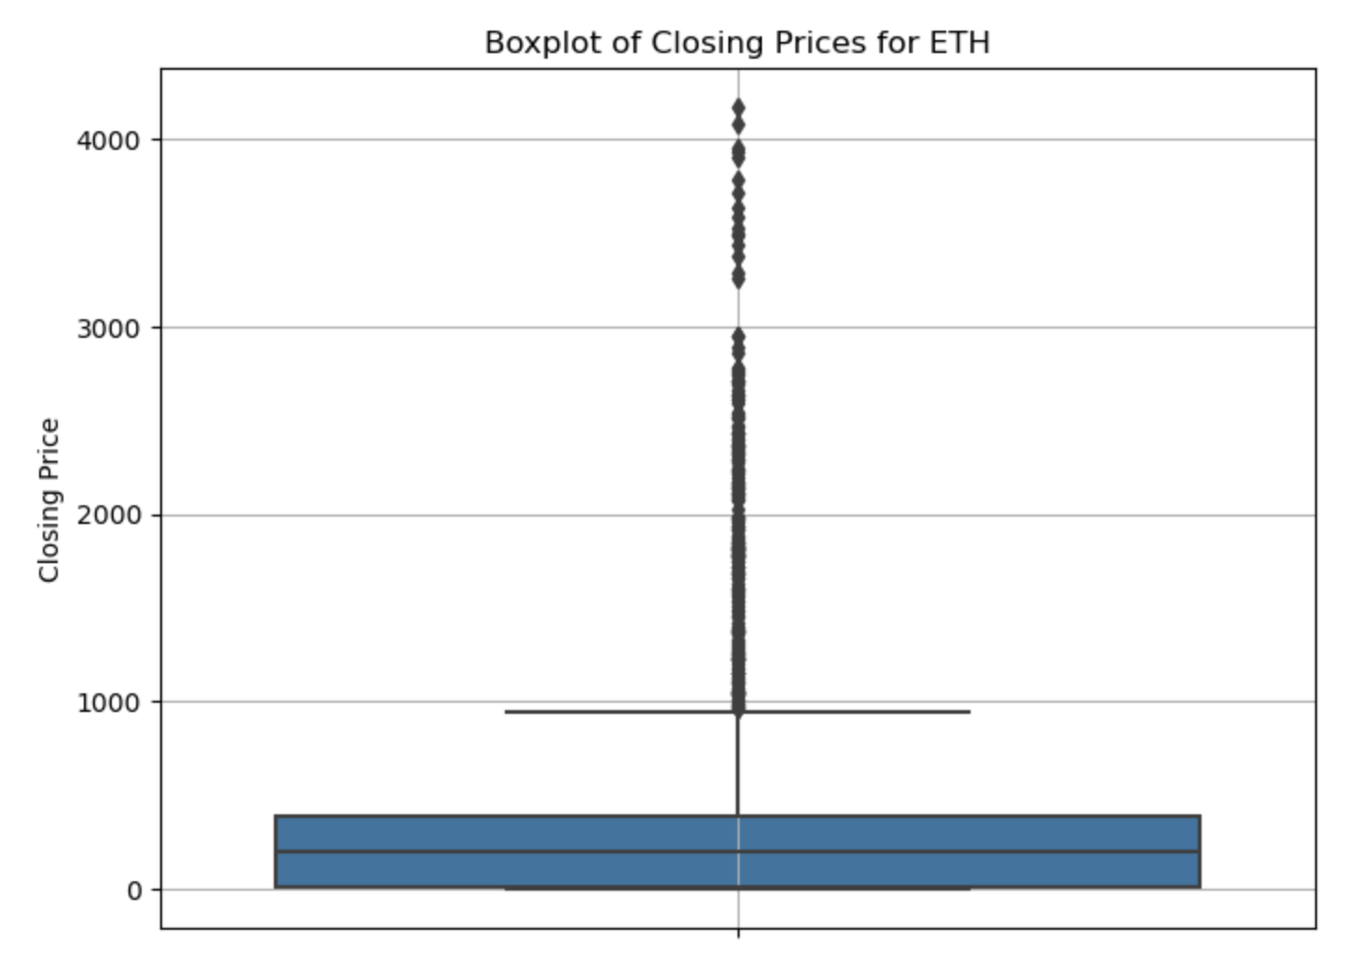
Box Plots - BTC and ETH
Boxplot of Closing Prices for BTC
Boxplot of Closing Prices for ETH
Notes:
Bitcoin (BTC) Box Plot:
- Price Distribution: The box plot shows that the majority of Bitcoin's closing prices are concentrated at lower levels, with a long upper whisker and many outliers. The box itself is compressed towards the lower end, indicating that Bitcoin’s prices have historically been low with significant spikes in recent years.
- Outliers: The numerous points above the upper whisker represent extreme price values, particularly from the significant price rallies seen in recent years, where Bitcoin reached highs of over $60,000.
Ethereum (ETH) Box Plot:
- Price Distribution: Similar to Bitcoin, Ethereum’s box plot shows that most of its historical prices are lower, with a compressed box near the lower end of the price range. The upper whisker and outliers indicate that Ethereum has also experienced significant price spikes.
- Outliers: The points above the upper whisker reflect the sharp price increases, particularly during the 2017 bull run and the more recent rallies, where Ethereum reached prices above $4,000.
Insights:
- Volatility: Both BTC and ETH exhibit significant volatility, with many outliers indicating that both cryptocurrencies have experienced substantial price fluctuations over time.
- Skewness: The distribution is heavily skewed to the right (positive skewness), indicating that while most prices have been low, both BTC and ETH have seen periods of extremely high prices, leading to the outliers.
- Historical Growth: The box plots visually capture the rapid growth of both Bitcoin and Ethereum, where significant price spikes have pulled the distribution upward, reflecting their increasing adoption and market value over time.

Slide 22
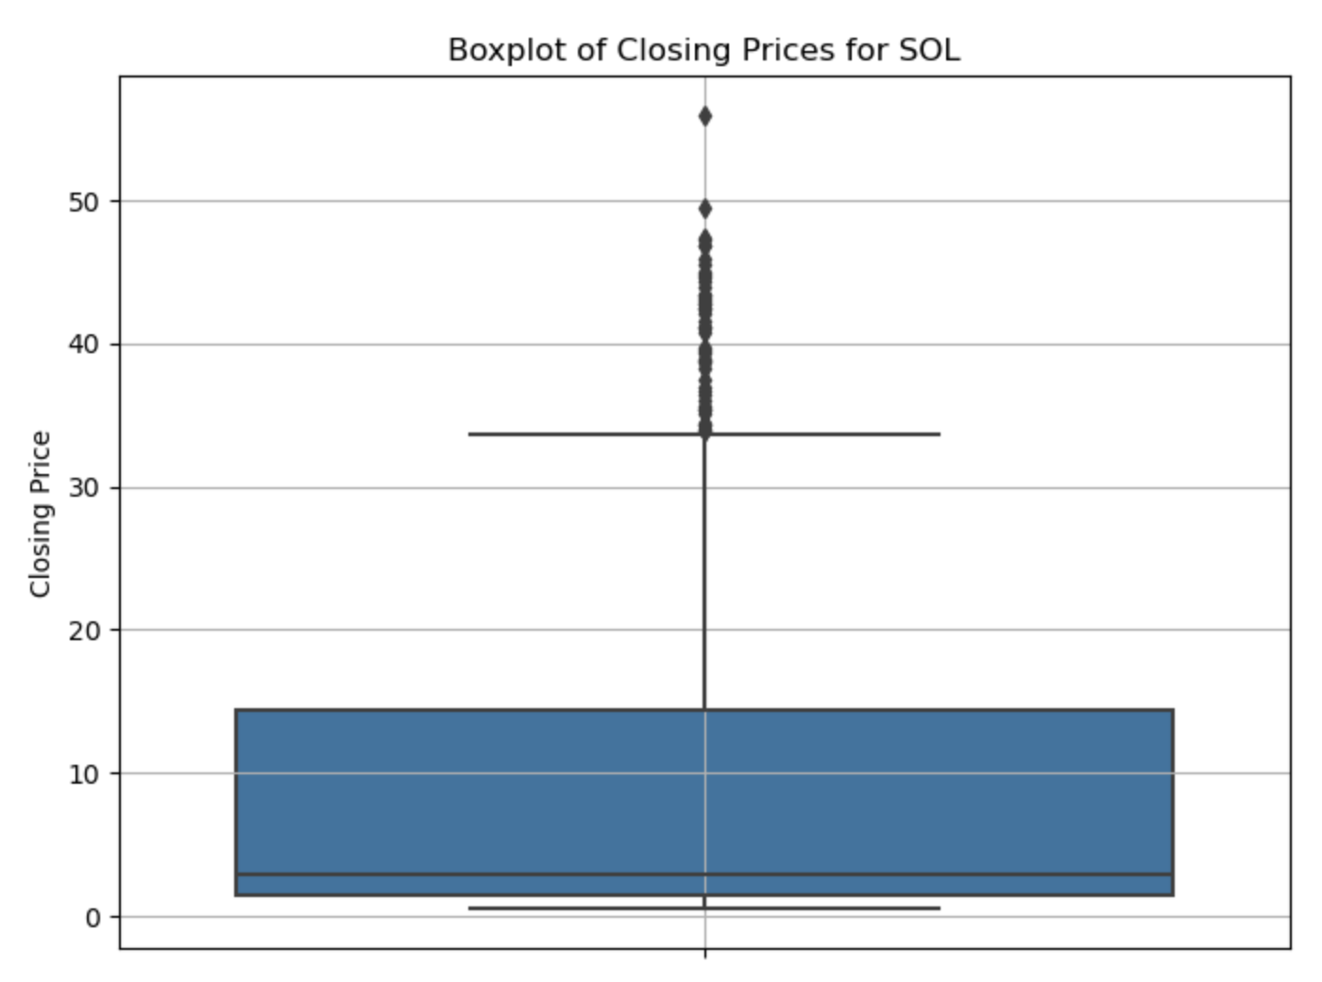
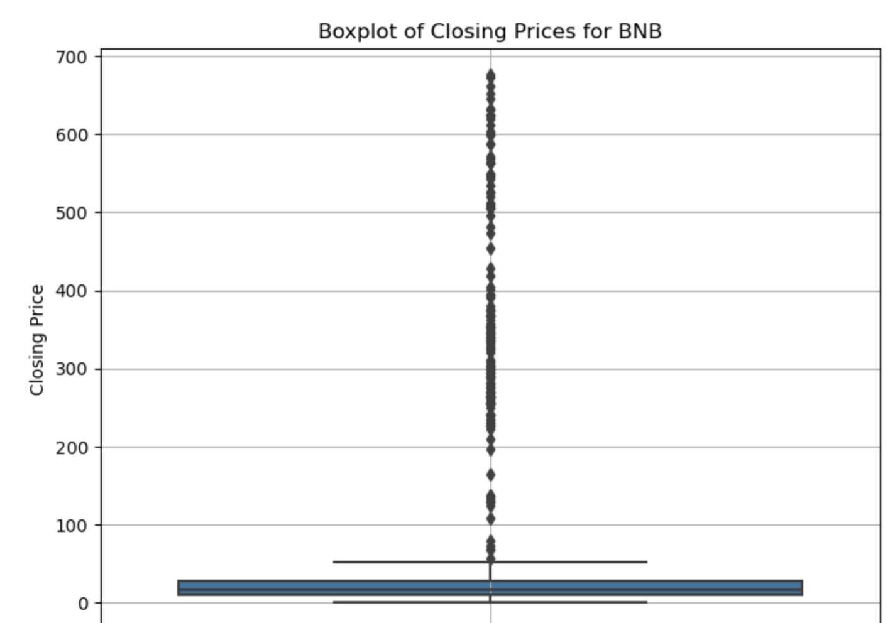
Box Plots - SOL and BNB
Boxplot of Closing Prices for SOL
Boxplot of Closing Prices for BNB
Notes:
Solana (SOL) Box Plot:
- Price Distribution: The box plot for Solana shows that most of the closing prices are concentrated at lower values, with the box extending from around \$10 to \$20. The upper whisker and outliers suggest that while most of the prices are lower, there have been significant price spikes, with some prices reaching above \$50.
- Outliers: The outliers above the upper whisker represent periods of rapid price increases, indicating times when Solana experienced sharp growth in value.
Binance Coin (BNB) Box Plot:
- Price Distribution: The BNB box plot indicates that most of its historical prices are very low, as shown by the compressed box near the lower end of the range. The upper whisker extends significantly, and there are many outliers reaching up to \$700, reflecting significant price increases in recent periods.
- Outliers: The numerous outliers represent the periods of rapid price appreciation, particularly during the bull runs that saw BNB's value skyrocket as Binance became more popular.
Insights:
- Volatility: Both SOL and BNB exhibit significant volatility, with many outliers indicating sharp price fluctuations over time.
- Growth Representation: The box plots capture the rapid growth of both cryptocurrencies, showing that while prices were historically low, recent periods have seen substantial increases, pulling the distribution upward.
- Positive Skew: The distribution in both plots is positively skewed, indicating that while most of the prices have been low, there have been periods of extremely high prices, reflecting the speculative and rapidly changing nature of these assets.

Slide 23
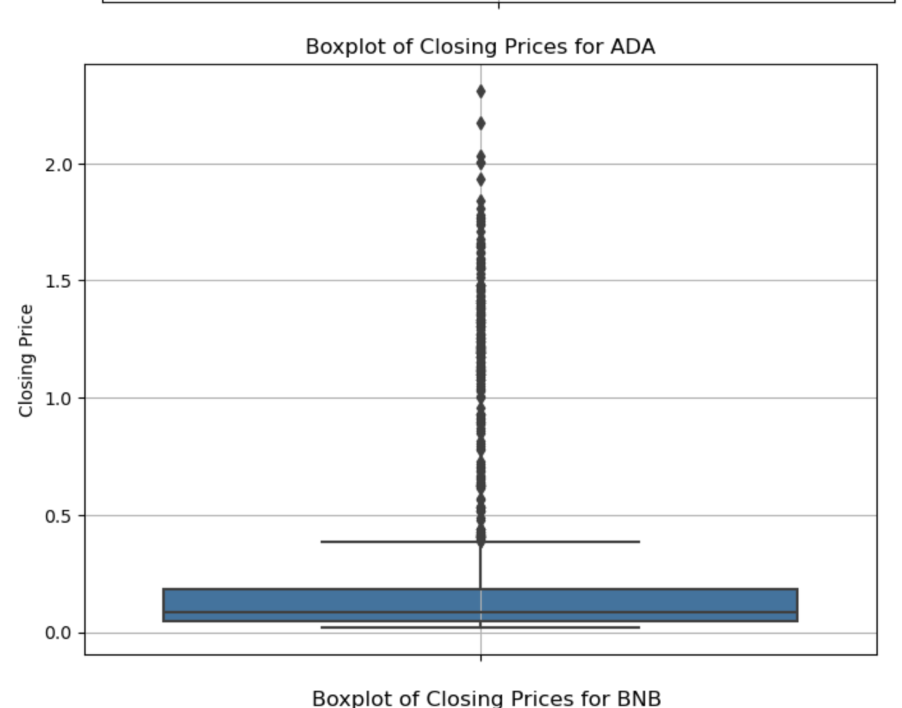
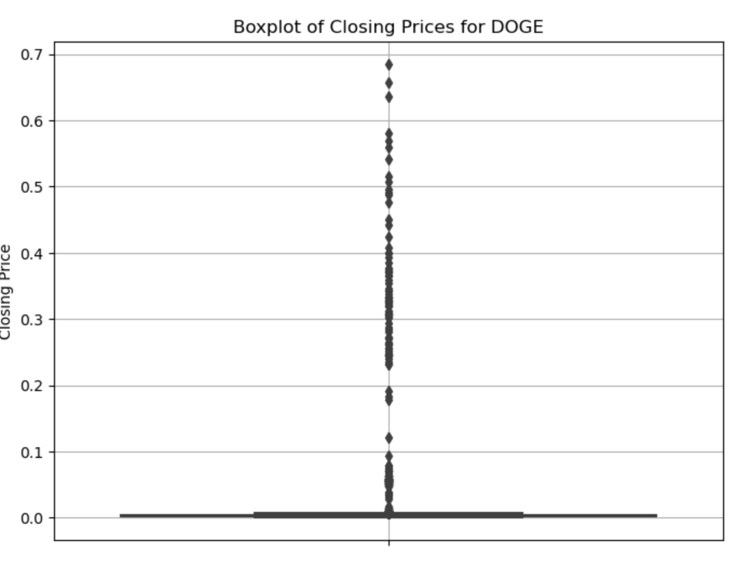
Box Plots - DOGE and ADA
Boxplot of Closing Prices for DOGE
Boxplot of Closing Prices for ADA
Notes:
Dogecoin (DOGE) Box Plot:
- Price Distribution: The box plot for Dogecoin shows that most of the closing prices are concentrated at extremely low levels, close to $0. The upper whisker and numerous outliers extend significantly, reflecting the sharp price increases seen during Dogecoin's speculative surges.
- Outliers: The outliers above the upper whisker represent periods when Dogecoin experienced dramatic price spikes, especially during the 2021 rally, where it reached highs close to $0.70.
Cardano (ADA) Box Plot:
- Price Distribution: The ADA box plot indicates that most closing prices are distributed at lower levels, with the box extending from around $0.1 to $0.5. The upper whisker and outliers suggest that while prices were generally low, Cardano experienced some significant price increases, pulling the distribution upwards.
- Outliers:The outliers above the upper whisker represent price peaks, particularly during bull runs where Cardano’s price surged, reaching highs above $2.
Insights:
- Volatility: Both DOGE and ADA show significant volatility, with many outliers indicating sharp price fluctuations over time. This is especially pronounced in Dogecoin, where speculative trading has led to extreme price movements.
- Growth Representation: The box plots highlight the speculative nature of Dogecoin, which has seen dramatic price surges despite historically low prices. Cardano’s box plot, while also showing volatility, reflects more gradual growth with notable peaks during market expansions.

Slide 24
Key Findings - Boxplots
Extreme Volatility
Positive Skewness
All six cryptocurrencies exhibit significant volatility, as evidenced by the numerous outliers in each box plot. These outliers represent periods of rapid price increases, which are common in the cryptocurrency market.
The box plots for all six cryptocurrencies show a positive skew, with most closing prices concentrated at lower levels and a few extreme values pulling the distribution upward.
BTC and ETH
BTC and ETH, the two largest cryptocurrencies by market cap, have box plots that reflect their long history and substantial growth over time. Both have numerous outliers representing periods of rapid price increases, but their boxes are relatively compressed, indicating that most historical prices were much lower than their peaks.
Nature of Dogecoin
SOL and BNB’s growth
Dogecoin’s box plot reveals its highly speculative nature, with prices remaining near zero for most of its history, followed by extreme spikes. The large number of outliers underscores the influence of social media and speculative trading on its price.
SOL and BNB have box plots that show a relatively compressed distribution at lower price levels but with significant upward extensions, reflecting their rapid price growth in recent years. The outliers for both indicate that they have experienced substantial price increases during specific periods.
Notes:
Based on the six box plots for Bitcoin (BTC), Ethereum (ETH), Solana (SOL), Binance Coin (BNB), Dogecoin (DOGE), and Cardano (ADA), here are six key findings:
1. Extreme Volatility Across Cryptocurrencies:
- All six cryptocurrencies exhibit significant volatility, as evidenced by the numerous outliers in each box plot. These outliers represent periods of rapid price increases, which are common in the cryptocurrency market.
2. Positive Skewness in Price Distribution:
- The box plots for all six cryptocurrencies show a positive skew, with most closing prices concentrated at lower levels and a few extreme values pulling the distribution upward. This indicates that while prices are generally low, there have been periods of significant price spikes.
3. Bitcoin and Ethereum's Historical Price Growth:
- BTC and ETH, the two largest cryptocurrencies by market cap, have box plots that reflect their long history and substantial growth over time. Both have numerous outliers representing periods of rapid price increases, but their boxes are relatively compressed, indicating that most historical prices were much lower than their peaks.
4. Speculative Nature of Dogecoin:
- Dogecoin’s box plot reveals its highly speculative nature, with prices remaining near zero for most of its history, followed by extreme spikes. The large number of outliers underscores the influence of social media and speculative trading on its price.
5. Rapid Growth in Solana and Binance Coin:
- SOL and BNB have box plots that show a relatively compressed distribution at lower price levels but with significant upward extensions, reflecting their rapid price growth in recent years. The outliers for both indicate that they have experienced substantial price increases during specific periods.
6. Cardano’s Gradual Price Increase:
- Cardano’s box plot, while showing volatility, reflects a more gradual price increase compared to some of the other cryptocurrencies. The distribution is wider and less compressed, suggesting that ADA’s price has seen more consistent growth with notable peaks during market expansions.
These findings highlight the unique characteristics of each cryptocurrency in terms of volatility, growth, and market behavior, providing valuable insights for investors and analysts.

Slide 25
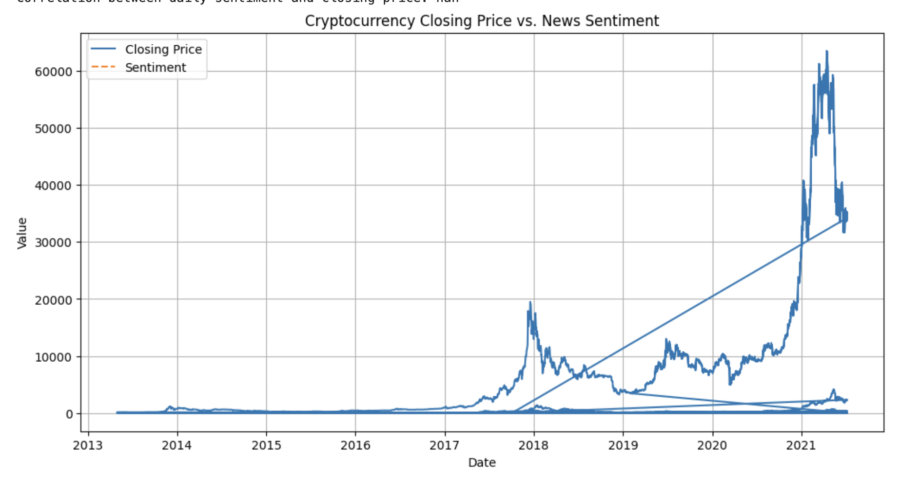
External News Event API
Explores potential correlation between news sentiment and cryptocurrency closing prices.
Lack of correlation (NaN) suggests misalignment of data or no significant relationship.
Serves as a starting point for further analysis:
Resolve NaN issue.
Ensure proper data alignment.
Explore alternative methods to capture and visualize the sentiment-price relationship.

Slide 26
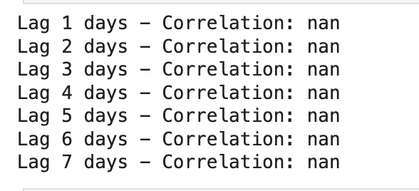
Lagged Sentiment Analysis based on API
Lagged sentiment analysis investigated if past sentiment impacts future cryptocurrency prices (1-7 days).
All correlations returned as NaN, indicating no measurable relationship.
Volatility analysis also showed a NaN correlation between sentiment and volatility.
Results suggest no significant connection between these variables in the provided dataset.
OUTPUT FOR LAGGED SENTIMENT

Slide 27
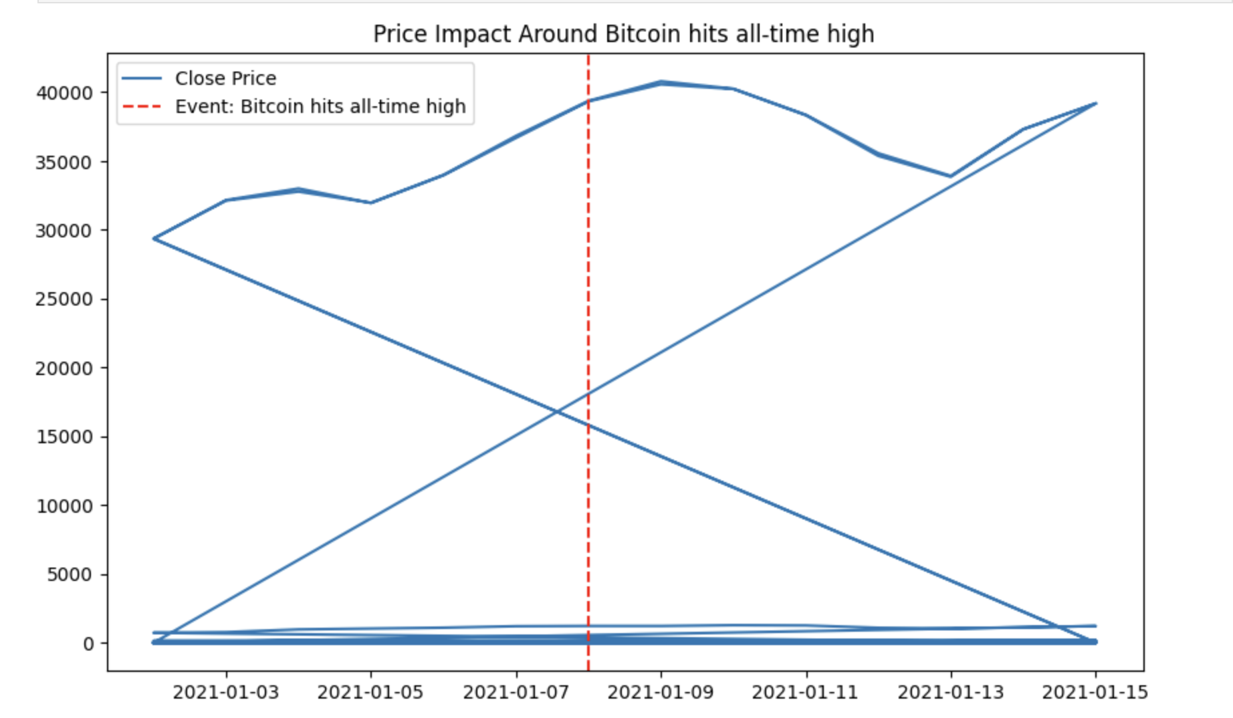
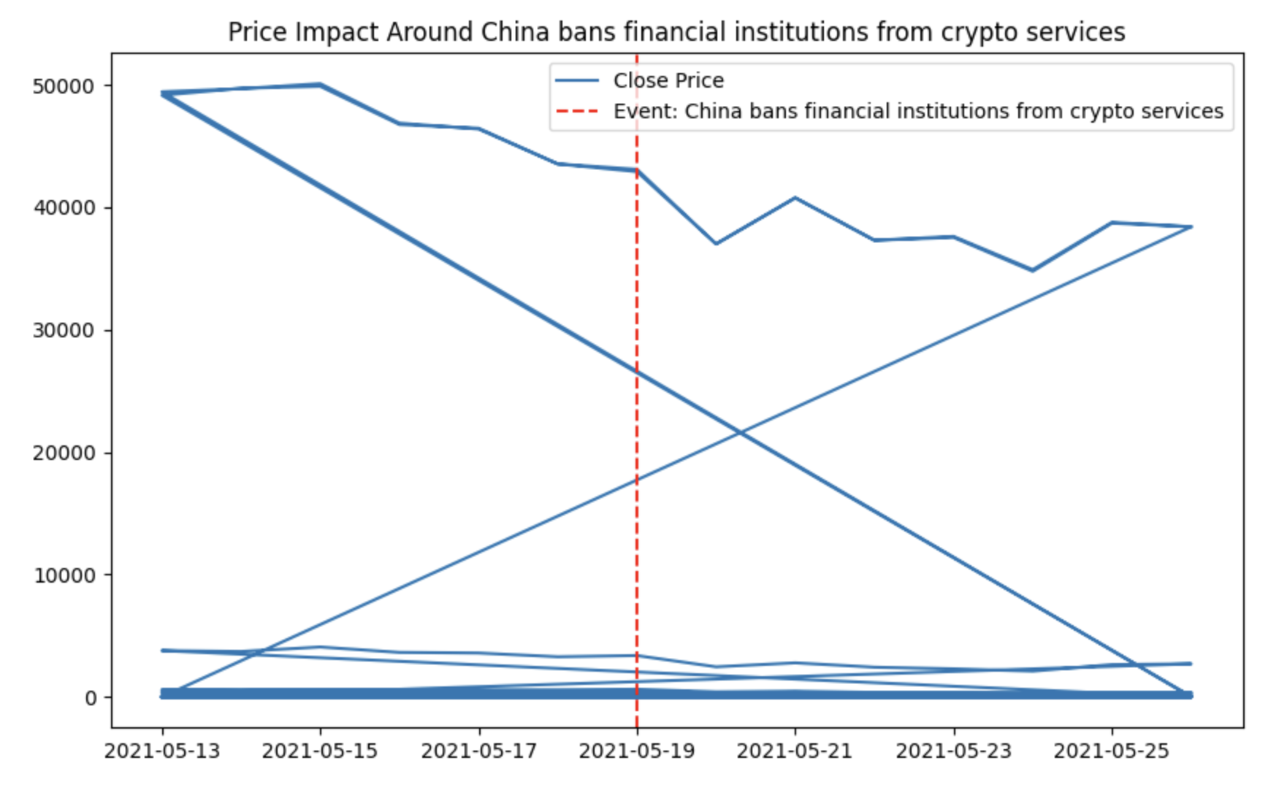
Event-Driven Analysis based on API
Bitcoin Hits All-Time High (Jan 8, 2021): The plot shows a positive price trend leading up to the high, followed by increased volatility.
China Bans Crypto Services (May 19, 2021): A significant price drop occurred, reflecting negative sentiment and potential panic selling.
Notes:
Key Insights: Certain events significantly impact cryptocurrency prices, emphasizing the importance of monitoring news and events to predict price movements.

Slide 28
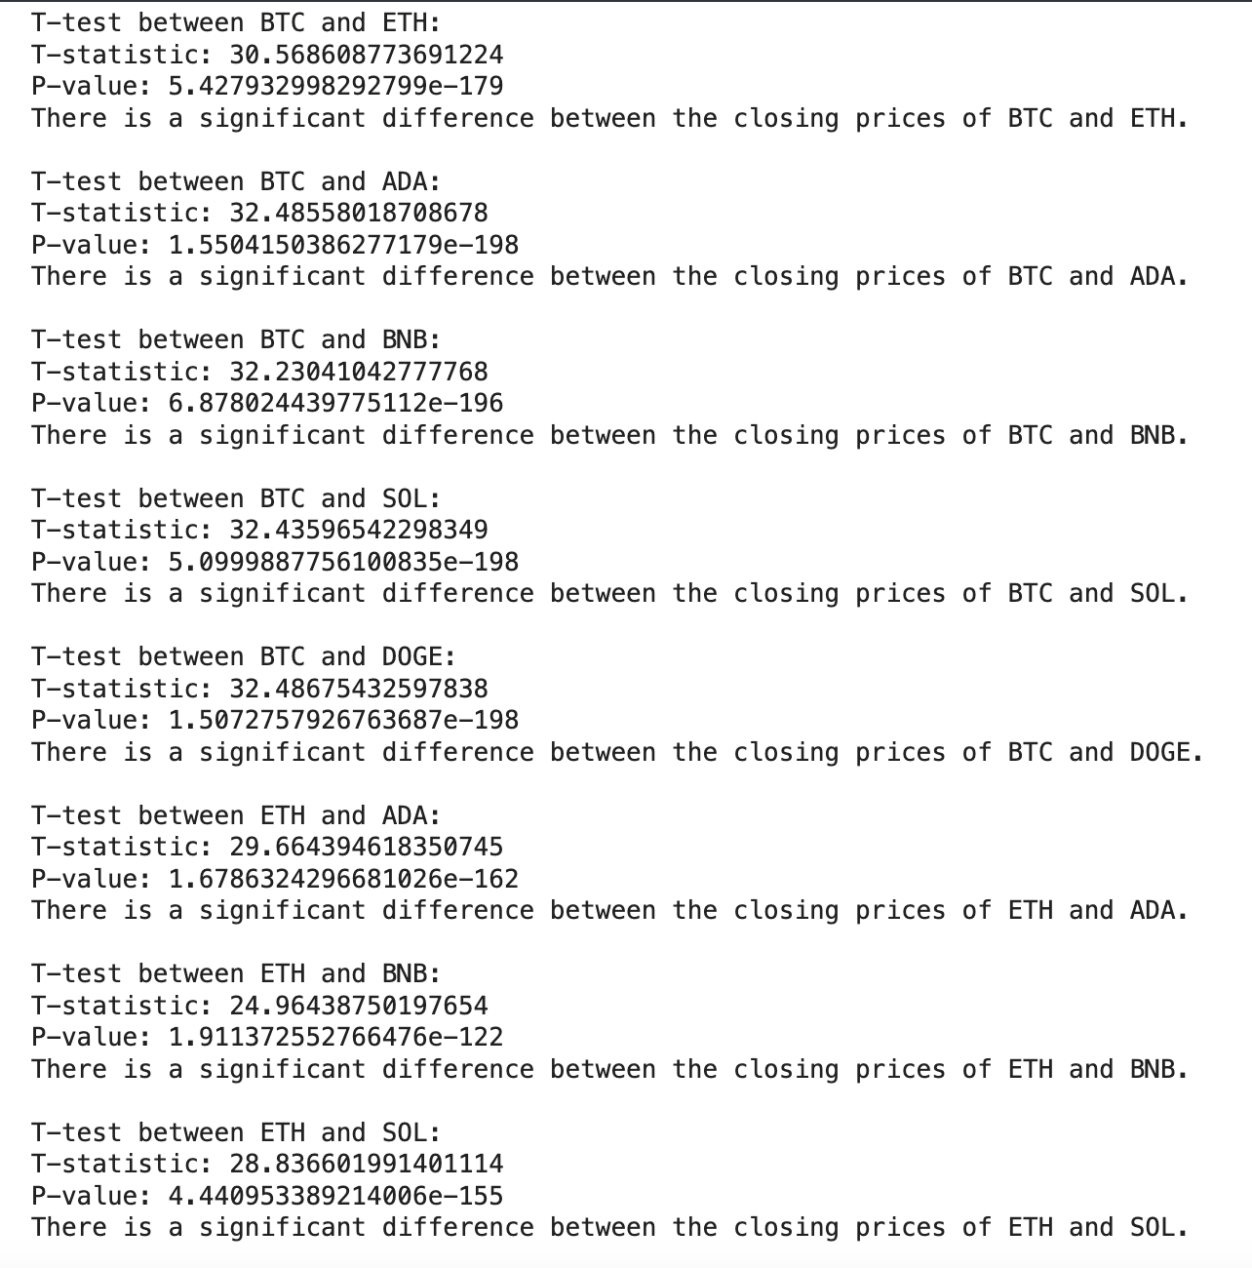
Independent Samples t-test for all pairs
BTC Correlations: No significant correlation (NaN) found between BTC and ETH, ADA, BNB, SOL, or DOGE.
ETH Correlations: No significant correlation (NaN) found between ETH and ADA, BNB, SOL, or DOGE.
ADA Correlations: No significant correlation (NaN) found between ADA and BNB, SOL, or DOGE.
BNB Correlations: No significant correlation (NaN) found between BNB and SOL or DOGE.
SOL and DOGE: No significant correlation (NaN) found between SOL and DOGE.

Slide 29
ANOVA (Analysis of variance)
ANOVA Test | Results
F-Statistic | 558.8760773539079
P-value | 0.0
Conclusion: The p-value (0.0) indicates a significant difference in the mean closing prices between the cryptocurrencies, meaning at least one cryptocurrency's mean price is statistically different from the others.
Implications: This suggests cryptocurrencies don't behave identically in the market, with some consistently having higher or lower prices, providing valuable insights for investors and analysts.

Slide 30
Chi-Square Test of Independence
Chi-Square Test | Results
Chi-Square Statistic | 23.957583636661617
P-value | 0.0005317235834825665
Interpretation: The p-value (< 0.05) indicates a significant relationship between price direction and the day of the week.
Conclusion: The day of the week may influence whether prices increase or decrease.
Implications: This insight could help traders and analysts develop strategies based on weekly price patterns.

Slide 31
Thanks!
Do you have any questions?

